Slide 1
Big Mountain Resort
A Ticket Pricing Analysis
Justin Hampton

Slide 2
Problem Identification
We have the suspicious that we aren’t capitalizing on everything we have to offer.
We aren’t sure how important certain features are in comparison to others
We have a lack of guidance on ticket pricing
We want to increase revenue and cut costs
…but how?

Slide 3
Key Findings
We have found strong, positive correlations between ticket price and vertical drop, area covered by snow makers, number of chairs, fast quads, run length, total runs, and skiable terrain. These are what customers are most willing to spend money on
Big Mountain Resort prices $81 for a ticket, we’ve found that the valuation of a ticket is likely up to $91.38
We’ve found that Big Mountain Resort ranks highly in the categories that customers care about

Slide 4
Recommendations
Increase ticket prices. The valuation of the resort, as is, is up to $91.83 for a ticket but we’re currently charging only $81.00
Add an additional 150 feet of vertical drop and an additional lift chair to accommodate this. We’ve found this will justify an additional price increase of $1.99 and generating $1,934,638 additional revenue after accounting for the cost of the lift chair
Close down the least popular run. We’ve found this will have no decrease in revenue and would save costs

Slide 5
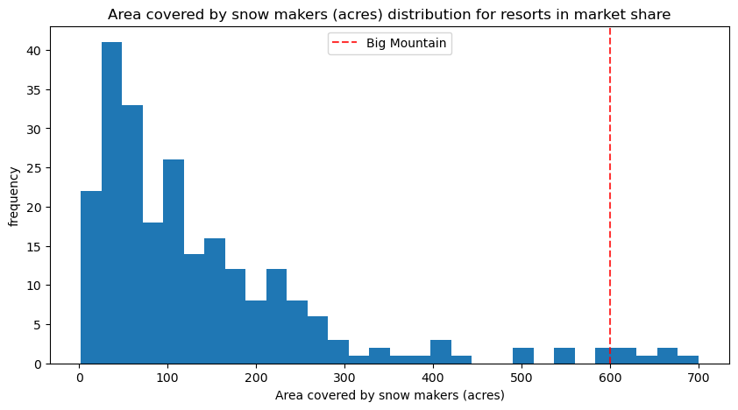
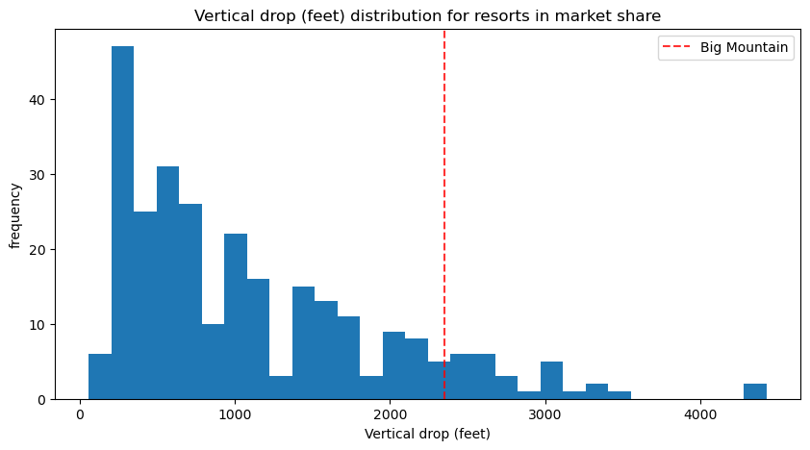
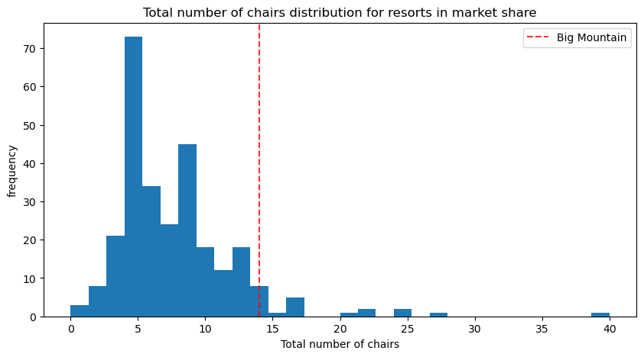
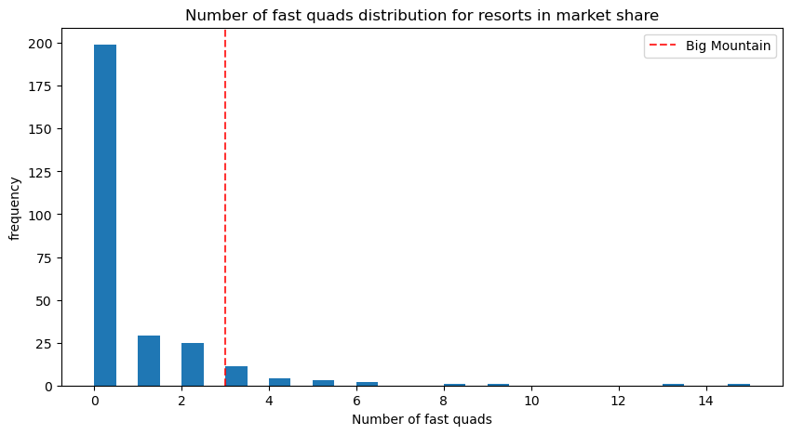
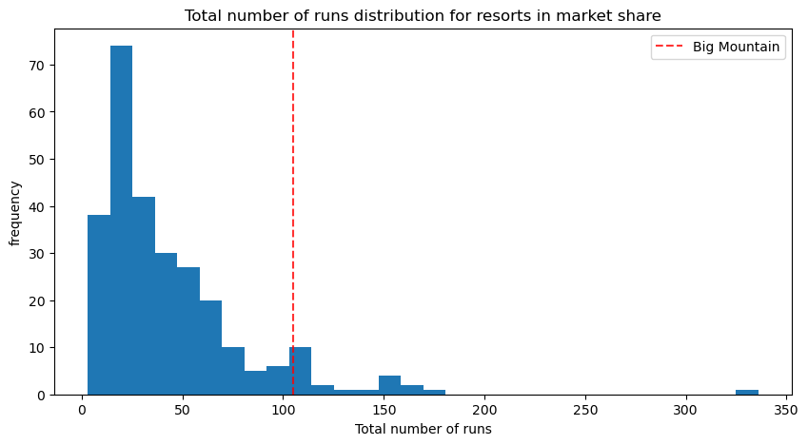
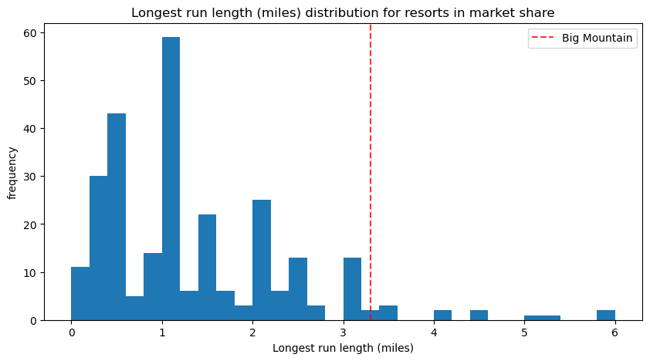
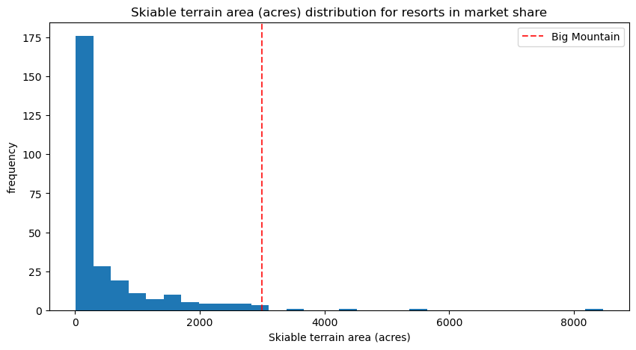
These graphs show that outside of a few resorts and a few outliers, Big Mountain Resort is consistently on the top end for important customer categories

Slide 6
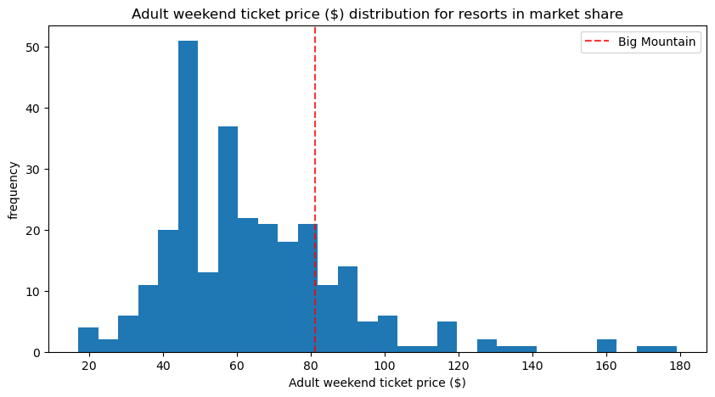
This figure shows that there are many resorts charging higher prices than Big Mountain Resort. As previously showed, we rank higher than our ticket prices would indicate, thus showing a visual representation of why higher ticket prices are justified

Slide 7
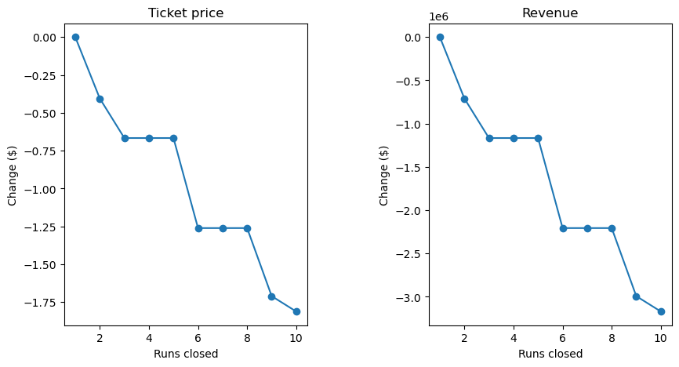
These figures show that closing one run would not cause a need for a lower ticket price and would not lower revenue.

Slide 8
Summary & Conclusion
The current price of a ticket is $81; a price of up to $91.38 could be a more accurate evaluation of the product. With 350,000 visitors, a price increase of $10.38 could lead to an additional $3,633,000 in gross revenue. We also found that increasing the vertical drop by 150 feet and adding an additional chair has the justification for a price increase of $1.99 with an expected revenue increase over the course of the season of $1,934,638 (increase revenue - operating cost). Closing one run would not decrease revenue, but would decrease operating costs.
Thus, my suggestion is to increase the cost of tickets by a minimum of $1.99 with the increased vertical drop of 150 and chair, but up to increase the cost of tickets by $12.37 total ($1.99 + $10.38) while also increasing the vertical drop by 150 and adding an additional chair. We also recommend closing the least popular run. These suggestions will add a minimum of $1,934,638 to a maximum of $5,567,638 increase in revenue while also reducing operating costs.

